Slide 1


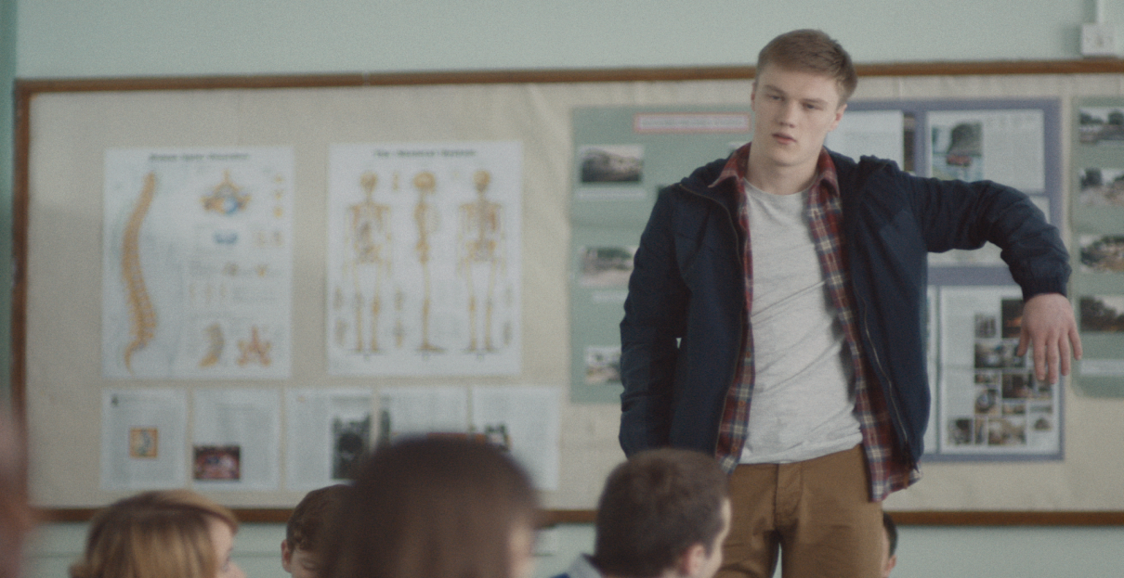
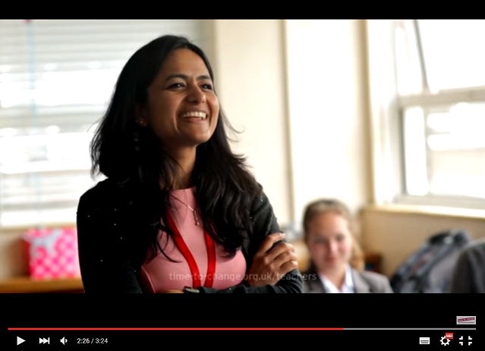
Section Title
Mental health in our school

Slide 2


Section 1: Why this matters

Slide 3

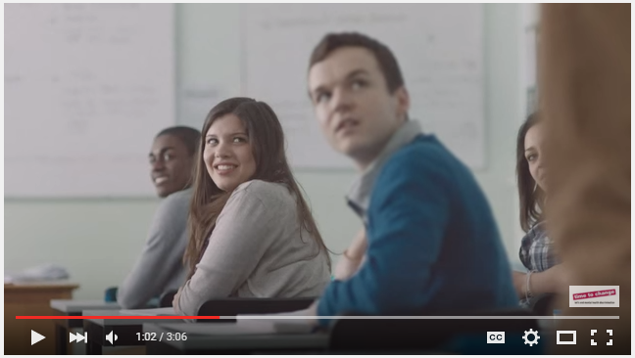
Mental health
Will the Stand Up Kid make you laugh?
[Click image for YouTube film]

Slide 4
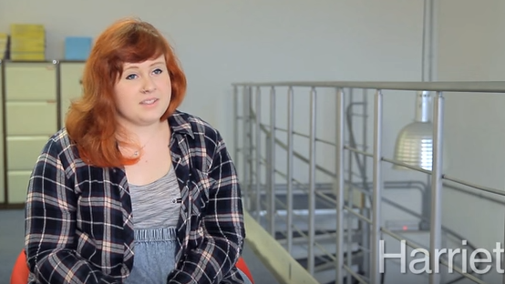
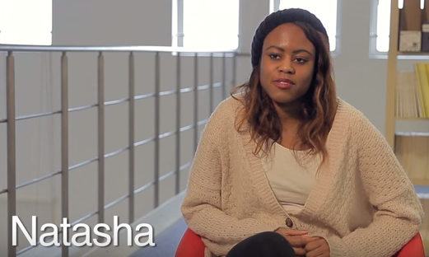
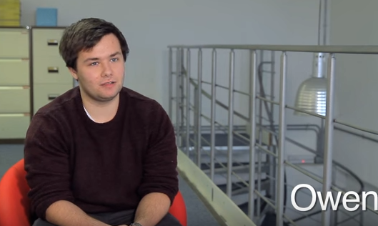
Mental health
The facts
We all have mental health, like we all have physical health.
1 in 10 children and young people will experience a mental health problem before the age of 16. That’s three students in an average-sized class.
1 in 4 adults will experience a mental health problem in any year.
Even if a young person doesn’t experience mental health problems directly, the statistics above suggest he/she is likely to know someone who is affected.

Slide 5
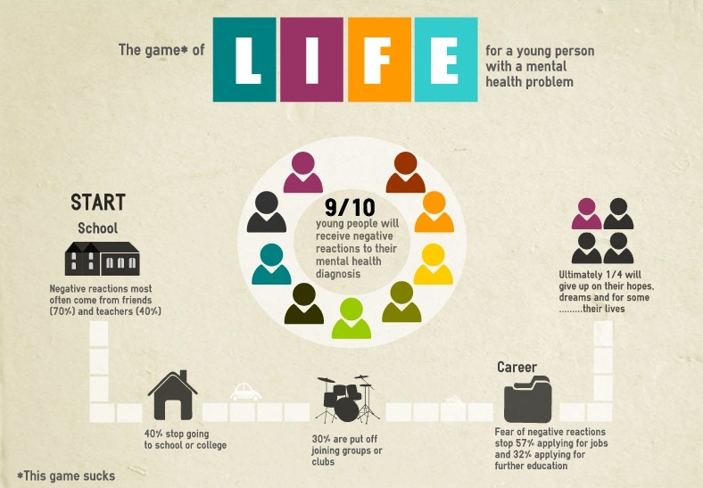
Mental health stigma
The current environment
9 in 10 of young people who experience mental health problems say they have experienced stigma and discrimination as a result.
Nearly 3 in 4 young people with mental health problem fear the reactions of friends.
Stigma stops young people seeking help if they need it. It stops them living normal lives, and can result in them giving up on hopes and dreams.

Slide 6
Creating an open culture
Being more open about mental health benefits us all
It can be an effective preventative strategy;
normalising the topic and the experience.
It enables young people to look after their own mental health and ask for help if they need it. It also helps them to support their peers or family members outside school.
Early intervention can have a huge impact and positively influence a young person’s recovery.
“We can make sure people are better able to seek support should they need it, and avoid reaching crisis points that inevitably have an impact on progress and learning, or success at work.”
Matthew Wright, Headteacher

Slide 7
Creating an open culture
Being more open about mental health benefits us all
Of course, as teachers, we can also be affected.
In a survey of Nasuwt teaching union, 83% respondents reported workplace stress.
Teaching is among the ‘three most stressed occupations’, according to research by a University of Manchester academic, quoted in the Times Educational Supplement (TES).
“We can make sure people are better able to seek support should they need it, and avoid reaching crisis points that inevitably have an impact on progress and learning, or success at work.”
Matthew Wright, Headteacher

Slide 8
Creating an open culture
You don’t need to be an expert
Conversations come in many forms. Short, informal chats can make a big difference.
One of the most significant things for young people is that they know they can come to talk to someone if they are worried – whether it’s about themselves or someone else.
Just being open to talking about mental health will almost always help. Showing you’re available, and that you care, will mean a lot.
“It’s not a question of enormous resource, or a massive amount of teacher time.
It’s just a change of mindset that you’re having these discussions.”
Kate Donovan, Deputy Head

Slide 9
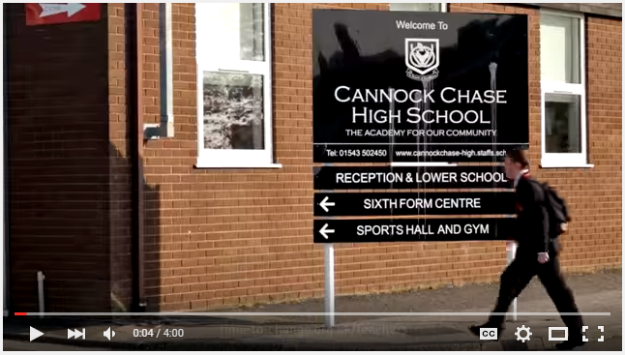
What peers say
Cannock Chase High, Staffordshire
[Click image for YouTube film]
[Click image for YouTube film]

Slide 10

Section 2: How we can get started

Slide 11
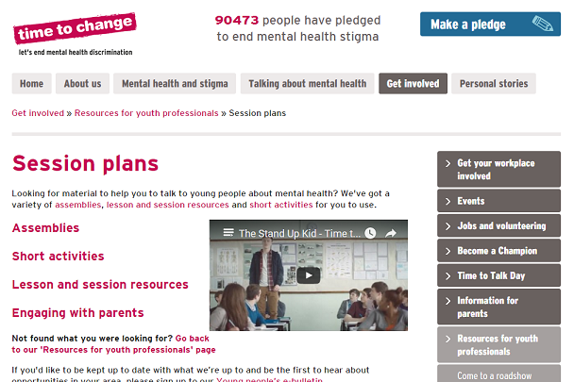
Leading the way
Becoming a pioneering school
We can download free, tried and tested mental health resources to support: Assemblies and sessions Events Student leadership Engaging parents Setting up local peer networks
time-to-change.org.uk/teachers

Slide 12
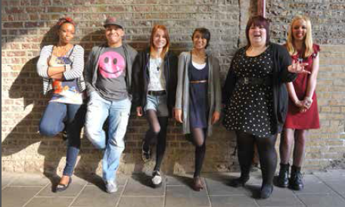
Forward planning
The next 12 months
[You might want to use this slide to add some suggestions for the next year]

