Slide 1


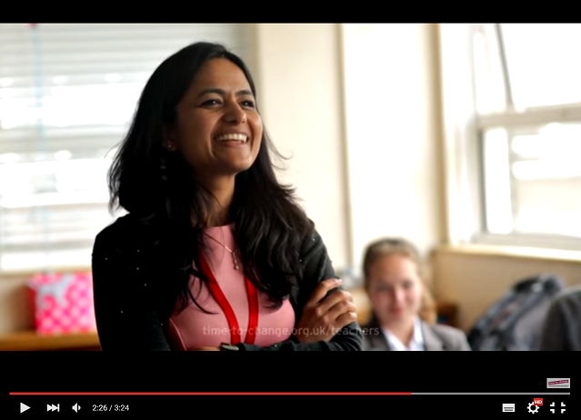
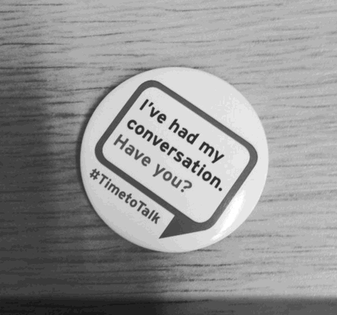
Section Title
Time to Change

Slide 2


Time to Change
Notes:
Time to Change is a nationwide behaviour change campaign funded by Big Lottery, Comic Relief and the Department of Health. Time to Change’s mission is to end mental health stigma and discrimination. Time to Change works with schools, businesses, organisations, local authorities and communities nationwide as well as online, to shift attitudes towards mental health and get the nation talking.

Slide 3

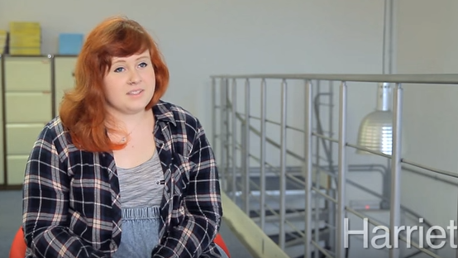

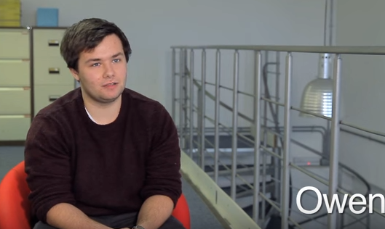
Mental health
The facts
We all have mental health, like we all have physical health.
1 in 10 children and young people will experience a mental health problem before the age of 16. That’s three students in an average-sized class.
1 in 4 adults will experience a mental health problem in any year.
Whether we have a mental health problem, or are just having a bad week, it helps to talk!

Slide 4
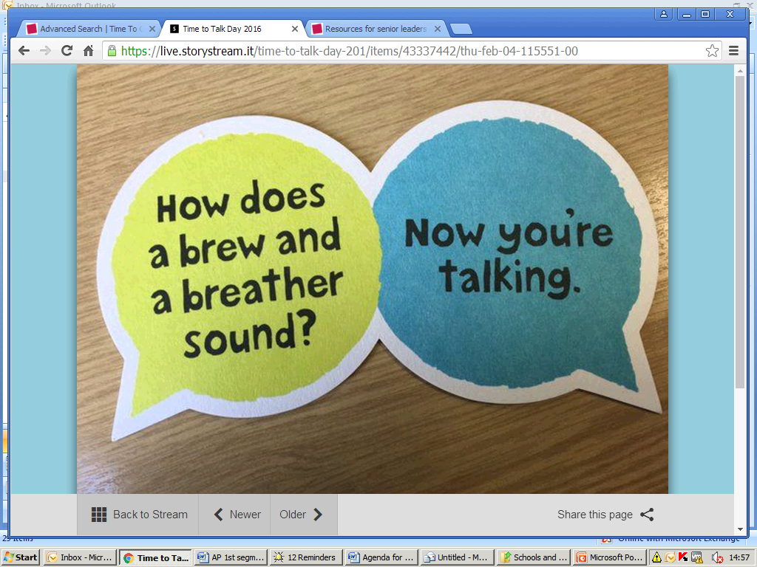
Mental health
Notes:
Grab a brew and a partner (perhaps someone you don’t work with on a day to day basis and rarely talk to) and sit down together for five minutes.
Some topics to discuss:
Public attitudes towards mental health problems
One high and one low from your week so far
One way in which you take care of your wellbeing

Slide 5

Our school
Notes:
You can now facilitate a brief group discussion about mental health provision within the school particularly focussed on staff wellbeing.
Ask staff to suggest ways in which they might be able to create a positive open culture around mental health amongst the staff body.
For example:
- would they like to institute ‘brew and a chat’ as a regular occurrence?
- would they like some mental health awareness training?
- what else could everyone do to feel more comfortable being open about mental health?

Slide 6
Section Title
Thank You

